Slide 1

GUI4Sher an Interactive Teaching Tool for Teaching GUI Graphics to Introduce Them to Computing: Visual Computing in Python
Dr. David B. Sher
Dept. of Math, Computer Science, Information Technology …
Nassau Community College
1 Education Dr.
Garden City NY 11530 USA
David.Sher@ncc.edu

Slide 2



Agenda
Computational Thinking
Graphics and GUI for Introductory Students
Inspirations
Downloading GUI4Sher
Using GUI4Sher
GUI4Sher Inspires Computational Thinking
Conclusions

Slide 3
Computational Thinking
Definition
Cornerstones
decomposition
  breaking down a complex problem or system into smaller, more manageable parts
pattern recognition
  looking for similarities among and within problems
abstraction
  focusing on the important information only, ignoring irrelevant detail
algorithms
  developing a step-by-step solution to the problem, or the rules to follow to solve the problem
Computational Thinking allows us to take a complex problem, understand what the problem is and develop possible solutions. We can then present these solutions in a way that a computer, a human, or both, can understand.*
Graphics and GUI Present Fun Opportunities for Computational Thinking

Slide 4
Graphics and GUI for Introductory Students
Graphics
GUI
Visual Arts attract introductory students.
Objects and Methods
Parameters (Constructors and Accessors):
  Colors
  Border Width
  Name
Programming with fun consequences
Interactive Graphics
Like cellphone apps
Controlling Text color, size, fonts
Event Functions
Intuitive Programming
Still Python

Slide 5
Inspirations for GUI4Sher
Visual Basic
GUI4Sher
Based on Graphics Package by John Zelle
  GUI4Sher changed names to be compatible with Python Style Guide PEP8
Used mouse to place items like Visual Basic
No menus, place items from shell
Single project file
AutoSave
Shell and IDE
Good: GUI placement with mouse
  No graphics
Good: IDE for Event Handlers
Bad: Confusing Menus
Bad: Project distributed in multiple files in multiple folders.

Slide 6
Downloading GUI4Sher
To download the GUI4sher package file click on this link GUI4sher Download
Save the file to an easily found folder
The file gui4sher.py is a gui4sher project creator
If you have python on your machine: clicking or executing this file will start with a menu that asks you to give a name to the project file.
The project file will accept GUI4sher commands in its shell and display the result in its graphics window.

Slide 7

GUI4Sher Graphics
Placing
Accessors
Colors

Slide 8
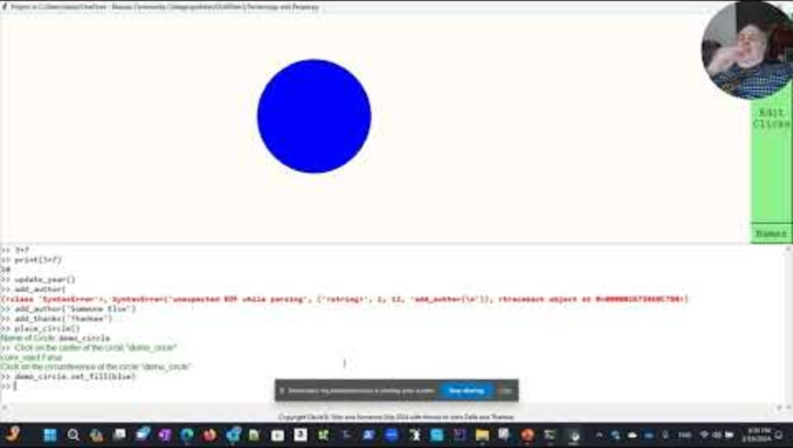
Starting Your Project
Description
Video
Install python and download project creator: GUI4sher Download
Project file location is on the top.
Graphics Window is next
Shell Window is next (commands to place graphics go here)
Copyright and Thanks are on the bottom.

Slide 9
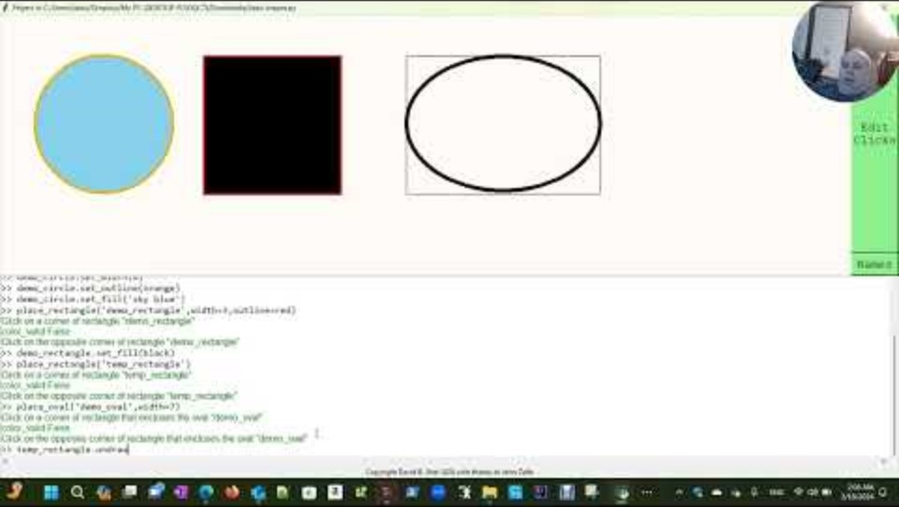
Placing Simple Graphics – Circles, Rectangles, Ovals.
GUI4Sher Commands
video
place_circle()
  Parameters: name,width,fill,outline
place_rectangle()
place_oval()
Common Colors:
  red,green,blue,white,black,gray,orange,purple,violet,
  yellow,brown,cyan,magenta,pink

Slide 10
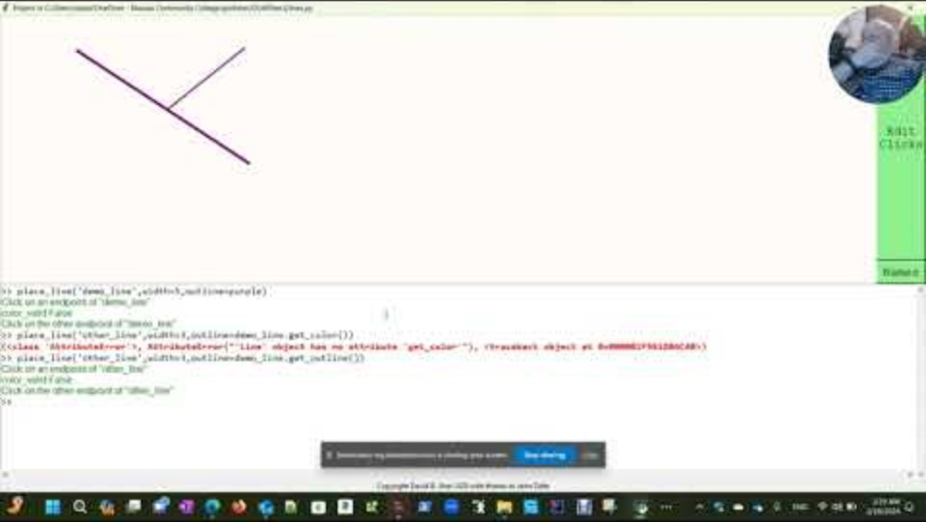
Placing Lines
Commands and Parameters
place_line()
place_dashed_line()
No fill for lines
Arrow parameter
  ‘none’ – no arrows
  ‘first’ – the first point clicked on
  ‘last’ – the last point clicked on
  ‘both’ – both ends of the line
Video

Slide 11
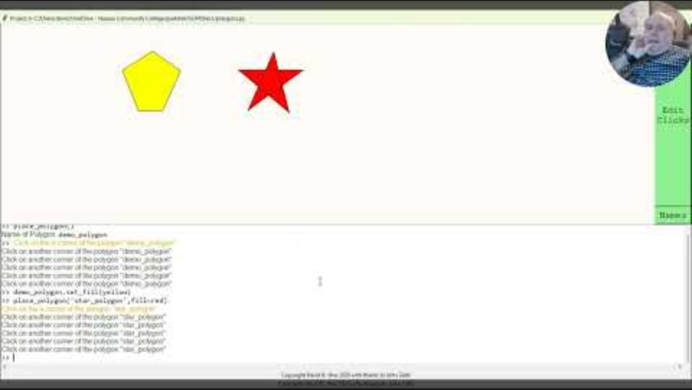
Placing Polygons
Commands
Video
place_polygon()
Clicking on large orange dot finishes polygon.
Doesn’t need to be convex

Slide 12
GUI4Sher GUI Widgets
Fonts
Parameters
Clicks Window IDE
Events

Slide 13
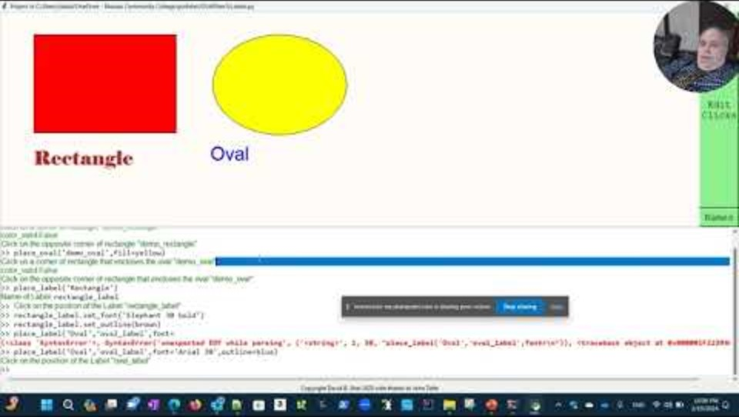
Labels
Commands
Video
Puts text into a project
place_label(‘Label’) requires a string argument
  Students are forced to use arguments for the first time.
Fonts by argument or set_font modifier
  Fonts are string with name, size, and style
  Example: “times 24 bold”
  Styles: bold italics plain

Slide 14
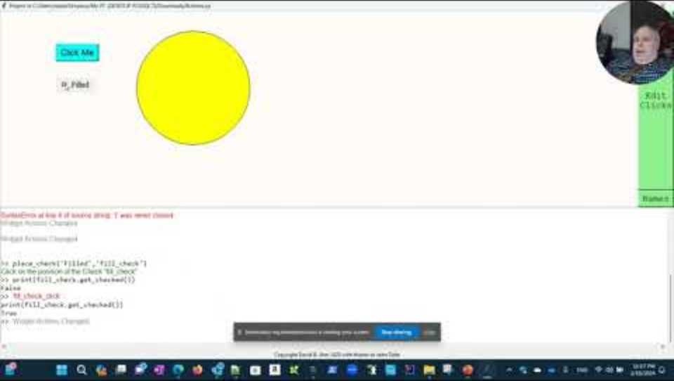
Buttons and Checks
Commands
Video
place_button(‘name’) or place_check(‘name’)
Font and text color controlled like a label
Fill like a rectangle
When they are clicked they create a click event and activate an event handling function
The clicks window is an IDE for writing the event handling functions.
The check also has a checked attribute.

Slide 15
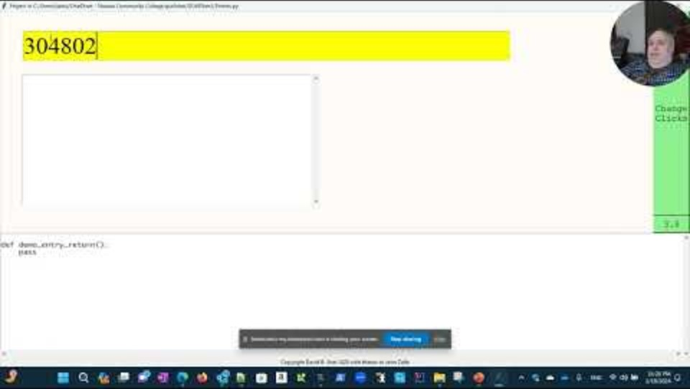
Entries and Texts
Commands
Video
place_entry(10) creates a one line textbox that can show 10 chars (first parameter required)
place_text(30,5) creates a textbox 30 characters wide with 5 lines.
Entries have a return event that happens when the user hits enter
text attribute holds the text in entries and texts.

Slide 16
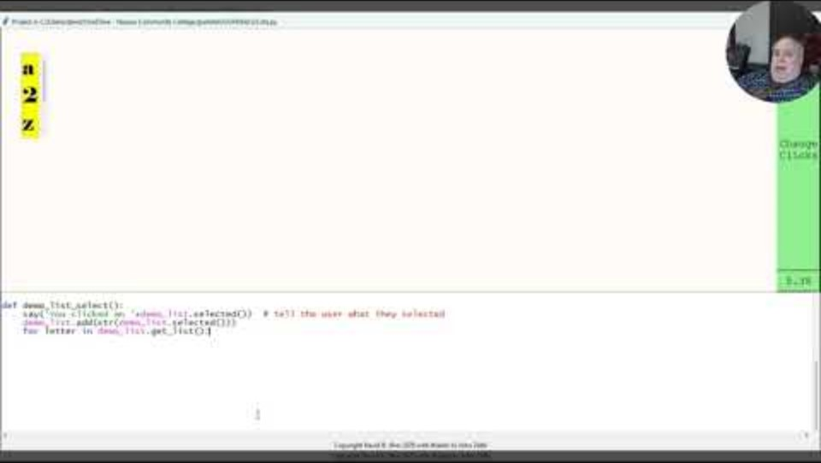
Lists
Commands
Video
Place_list([‘a’,2,’z’]) can place a list in the graphics window.
The list widget is not a list.
  To get the list from the widget use get_items() method
Used to inspire students about iteration.
add method adds items to list but doesn’t change the size of the widget

Slide 17

Summary
GUI4sher can inspire computational thinking in a fun way.
It does visual programming like Visual Basic but in a python style.
Students can build simple graphics and GUI programs.

Slide 18


Thank You
Dr. David B. Sher
David.Sher@ncc.edu
matcmp.ncc.edu/sherd/GUI4sher/

